Slide 1

APPLIED SIGNAL PROCESSING LABORATORY ASSIGNMENT 1
Paolo Allione s296500
Camolese Claudio s297378
Temmuz Sanli s298029

Slide 2
A1.1

Slide 3
A1.1 Energy of a rectangular pulse
Exercise A1.1 can be structured as follows:
After generating a rectangular pulse signal, plot the pulse on the time axis
Compute the FFT of the signal in the fundamental interval and then compute the FFT magnitude on the frequency axis
Compute and plot the percentage of energy contained in the first 10 lobes and then the one contained from 10 to 100 lobes.

Slide 4
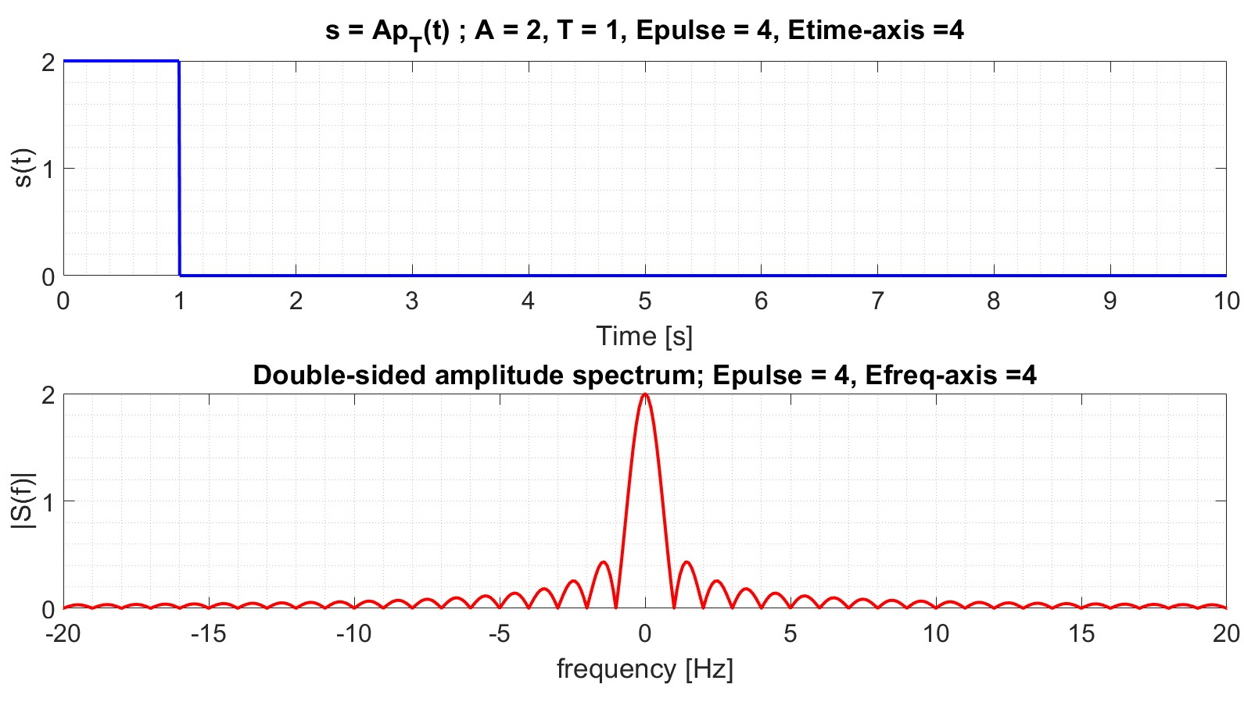
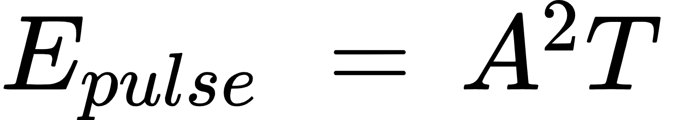
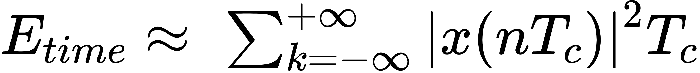
Rectangular pulse
The Matlab figure shows two plots of the signal.
The upper plot is the rectangular signal with A=2 and T=1. In the title are present two energy values which are obtained as follow:
The second plot shows the magnitude of the Fourier transform of the latter signal on the frequency axis.
As we can notice from the figure, the Fourier transform of the rectangular pulse is a sinc signal. Furthermore, Parseval’s identity is verified.

Slide 5
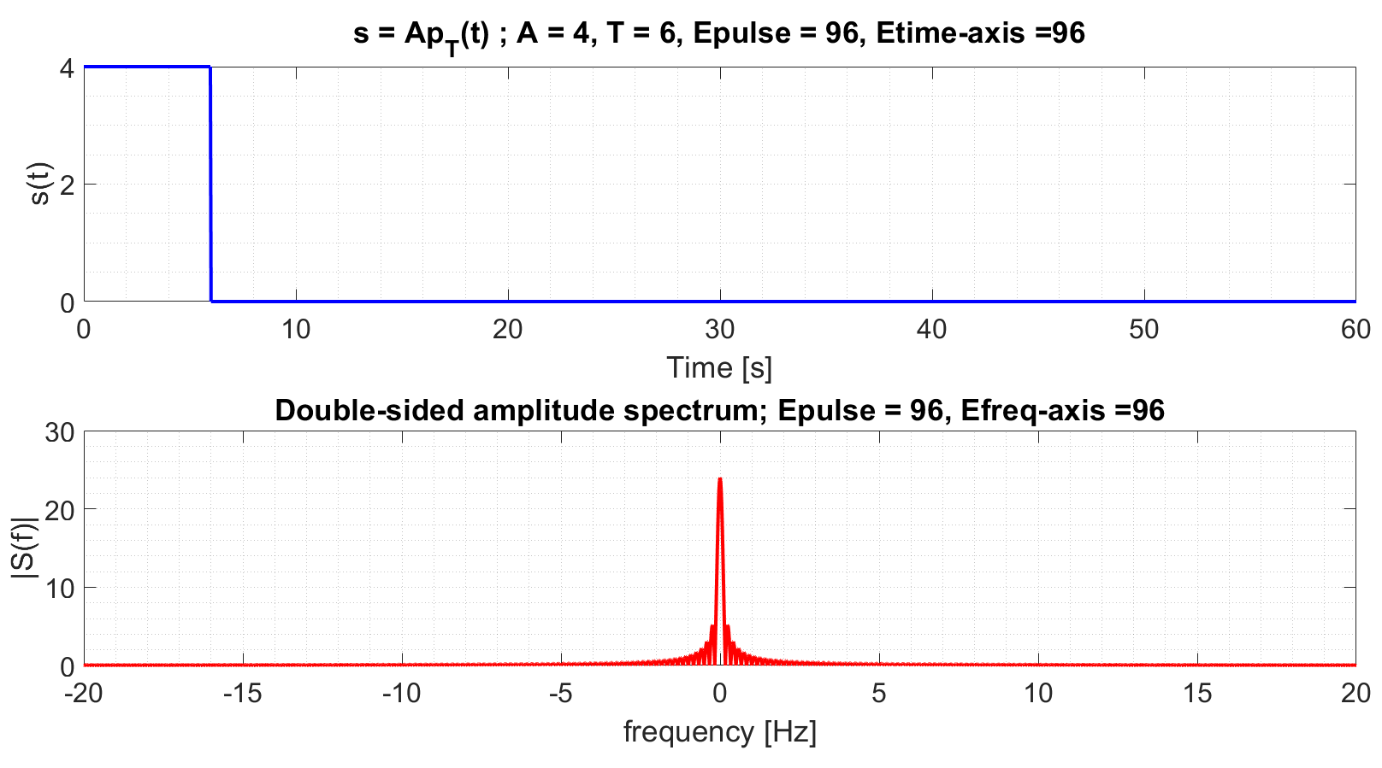
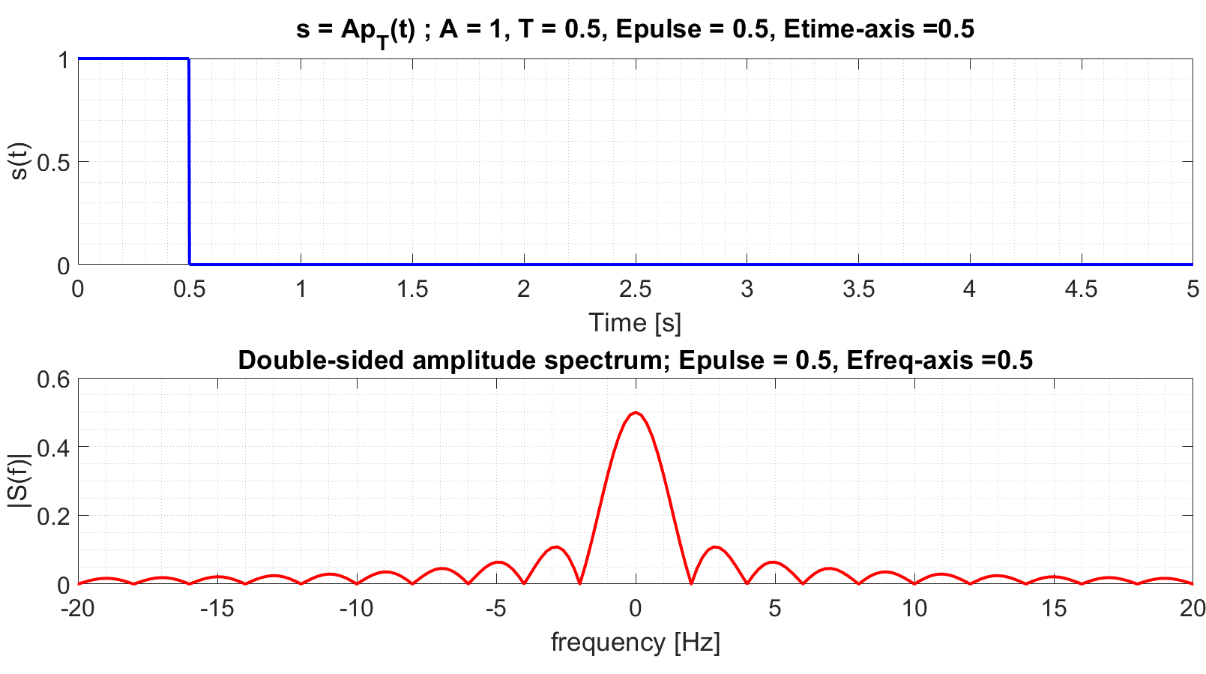
Other examples
By modifying the values of A and T, two examples of the signal and its Fourier transform are shown.
Decreasing the frequency leads to narrower lobes in the frequency spectrum and in a higher value of the energy due to concentration.
Increasing the frequency leads to wider lobes in the frequency spectrum and in a lower value of the energy due to the dispersion.

Slide 6
Energy in lobes
The goal of this section is to compute and plot the percentage of energy contained in 10 lobes and then in the range from 10 to 100.
The lobes are useful because they are linked to a specific frequency and show how much energy is distributed in these frequencies.
Taking advantage of the spectrum symmetry, it is sufficient to double the energy in the positive frequency axis and compute the result.

Slide 7
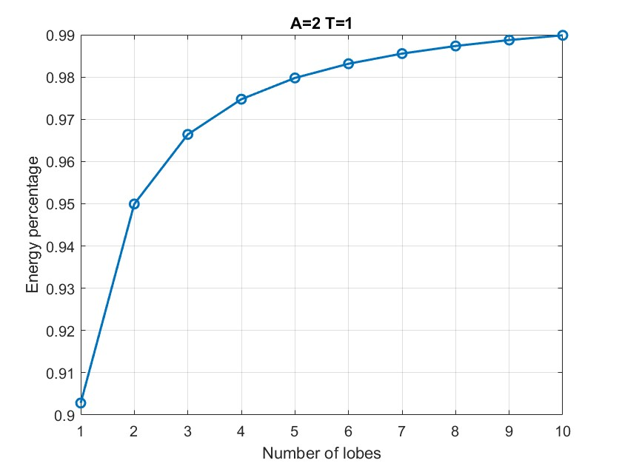
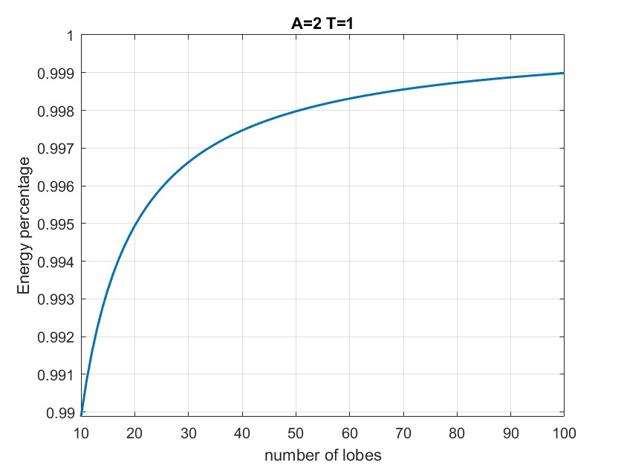
As it can be observed, the greatest contribution of energy is produced by the first 10 lobes. The more lobes we consider, the more their contribution becomes negligible.
Because of that, the total energy of a rectangular pulse is, in first approximation, contained in the first lobe.

Slide 8
A1.2

Slide 9
A1.2 Filtering of 3 sines on the frequency axis
SIGNAL GENERATION
Our composite signal is formed by summing three sinusoidal signals with different frequencies and random phases:
Here, 𝑓𝐴=1, 𝑓𝐵=2, and 𝑓𝐶 =3 represent the frequencies of the sinusoidal signals, while 𝜙𝐴 , 𝜙𝐵 and 𝜙𝐶 are random phases.

Slide 10
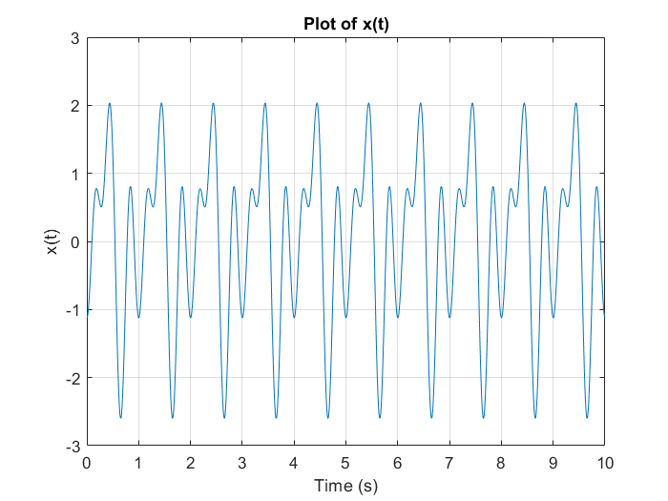
Time-Domain Analysis
We begin by plotting the composite signal in the time domain, which allows us to visualize its waveform and amplitude variations.
The composite signal shows periodic behavior with special patterns corresponding to the individual sinusoidal components.

Slide 11
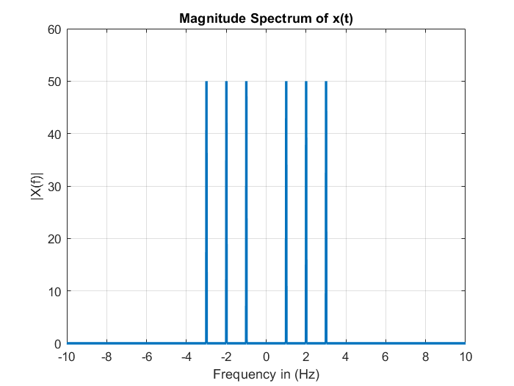
Frequency-Domain Analysis
Next, we analyze the frequency content of the composite signal by computing its Fourier transform and plotting the magnitude spectrum.
The peaks in the spectrum correspond to the frequencies of the individual sinusoidal signals, providing insights into their presence and magnitude.

Slide 12
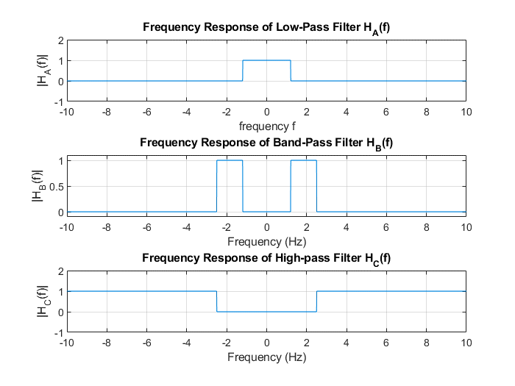
Filter Design:
To isolate each sinusoidal signal, we design specific filters: a low-pass filter 𝐻𝐴(𝑓) for 𝑓𝐴, a band-pass filter 𝐻𝐵(𝑓)for 𝑓𝐵 , and a high-pass filter 𝐻𝐶(𝑓) for 𝑓𝐶 .
These filters are designed to selectively pass the desired frequency components while preventing others.

Slide 13
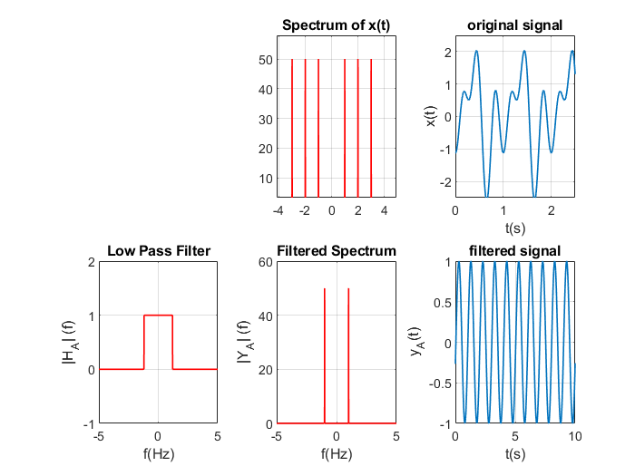
IFFT and Filtered Signals
We take each filter to the composite signal by multiplying its frequency response with the inverse Fourier transform of the signal.
This process separates the desired sinusoidal components, yielding filtered signals corresponding to 𝑓𝐴, 𝑓𝐵 and 𝑓𝐶.

Slide 14
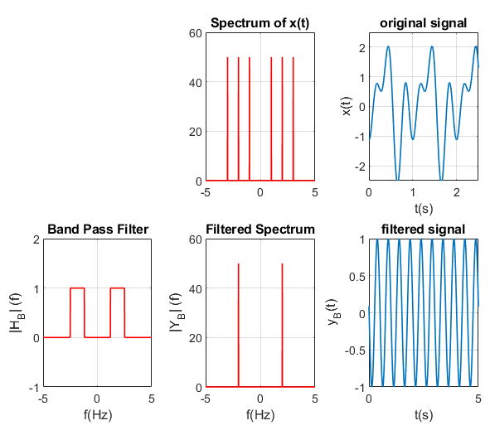
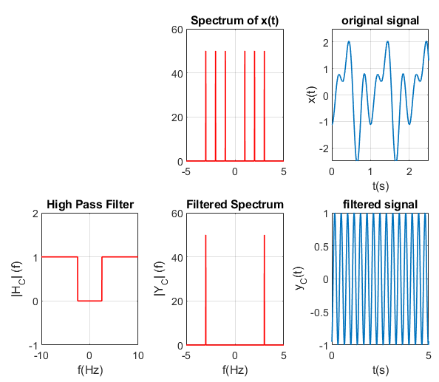
Other Signals

Slide 15
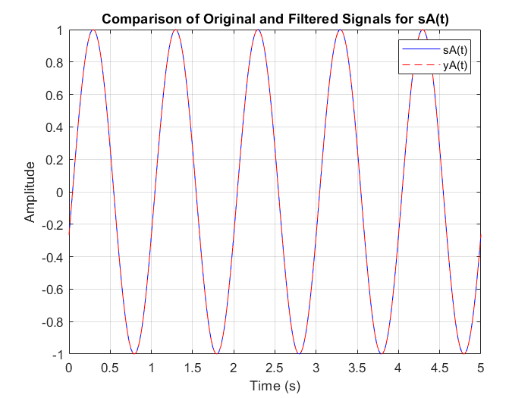
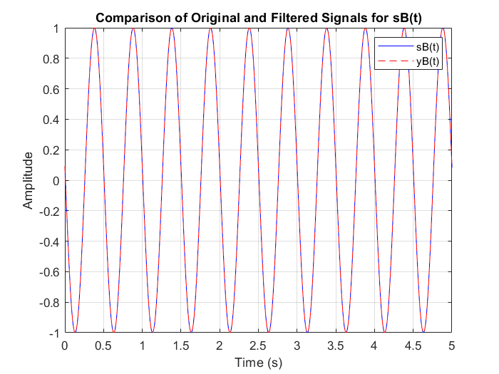
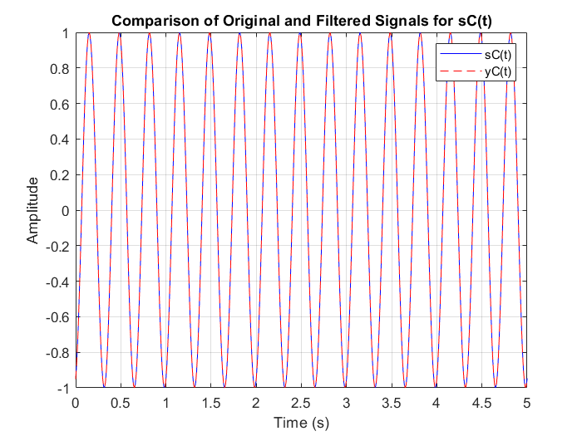
Verification
To confirm the accuracy of the filtered signals, we compare them with the original sinusoidal signals. This validation step guarantees that the filtering process maintains each component signal.

Slide 16
A1.3

Slide 17
A1.3 Quantization
Exercise A1.3 can be structured as follows:
After generating a sinusoidal signal, plot the original signal s(t) and the quantized signal s_{q}(t).
Compare the spectrum of the original and the quantized signal in dB.
Compute the SNR of the signal.

Slide 18
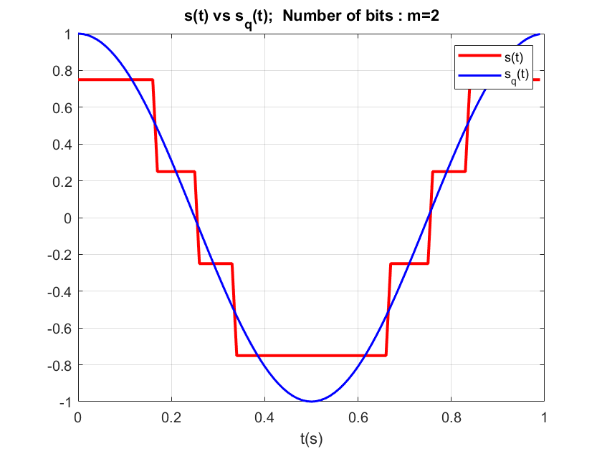
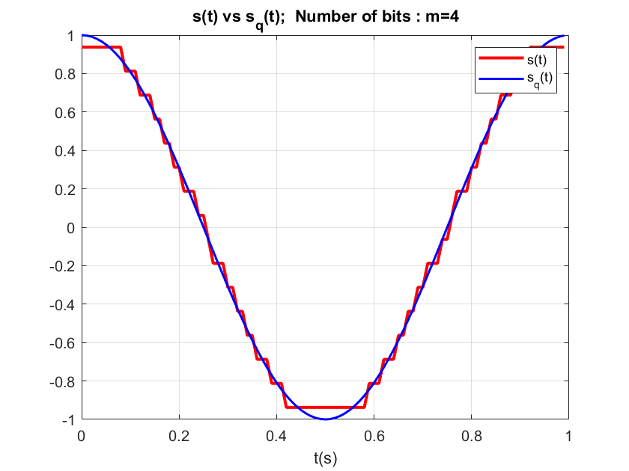
Quantized signal
The two plots consider the original signal and compare it with the quantized signal obtained with m=2 and then m=4, where m is the number of bits.
As it can be observed, the more bits we use the more the quantized signal is similar to the original.

Slide 19
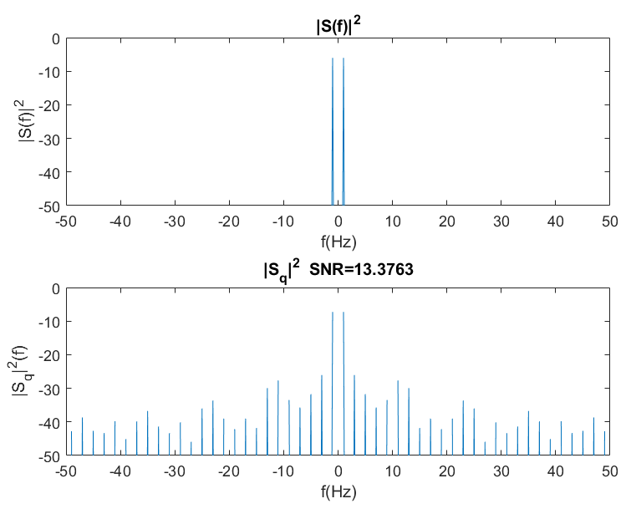
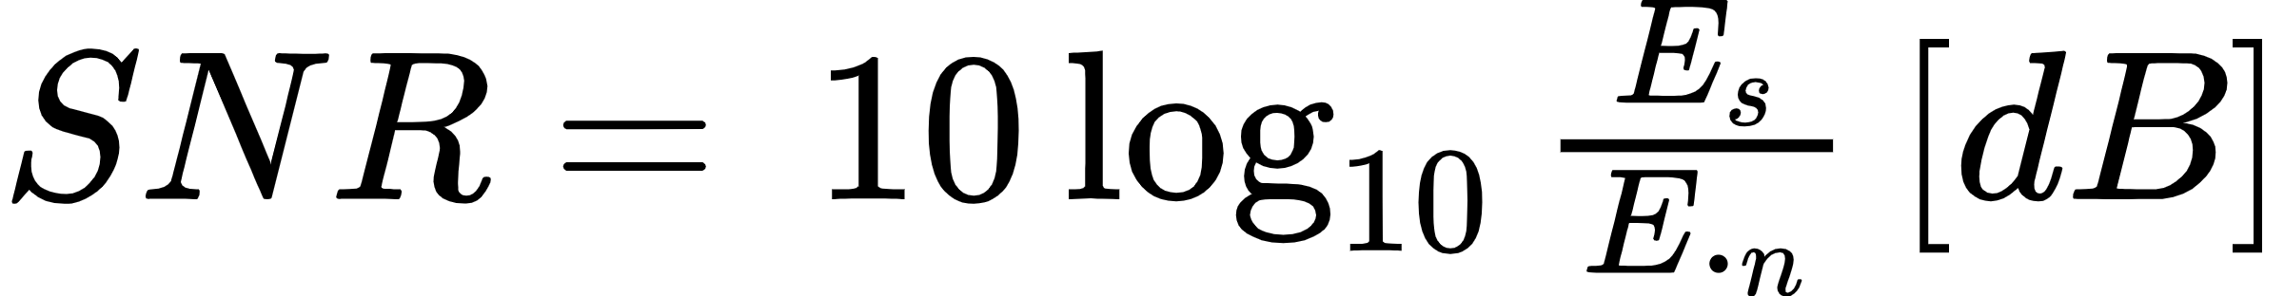
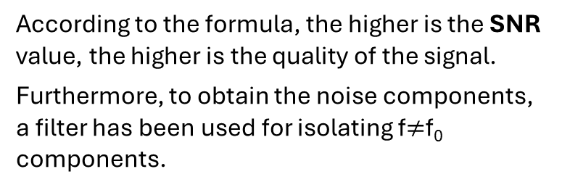
Spectrum analysis
The figure compares the spectrum of the original and quantized signal. The values are plotted in [dB].
The SNR value is also presented.
SNR (Signal-Noise-Ratio) is a measure of the quality of a signal and indicates how strong the signal is relative to the background noise present.
It has been obtained using the known formula:
According to the formula, the higher is the SNR value, the higher is the quality of the signal.
Furthermore, to obtain the noise components, a filter has been used for isolating f$≠$f₀ components.

Slide 20
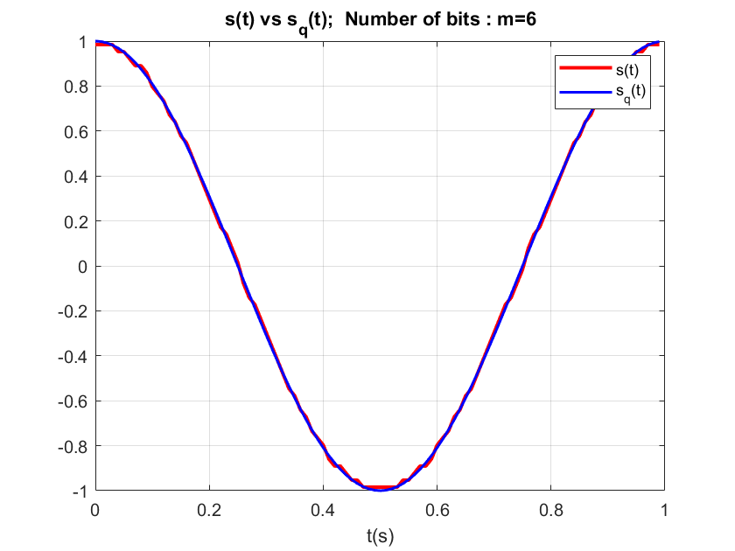
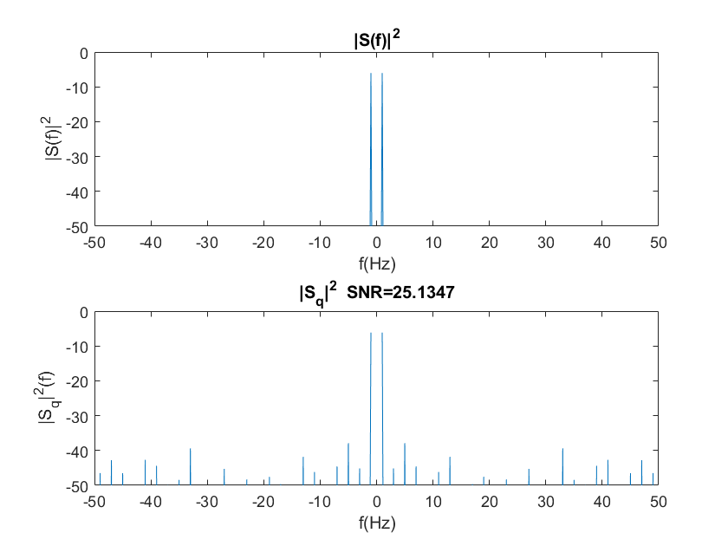
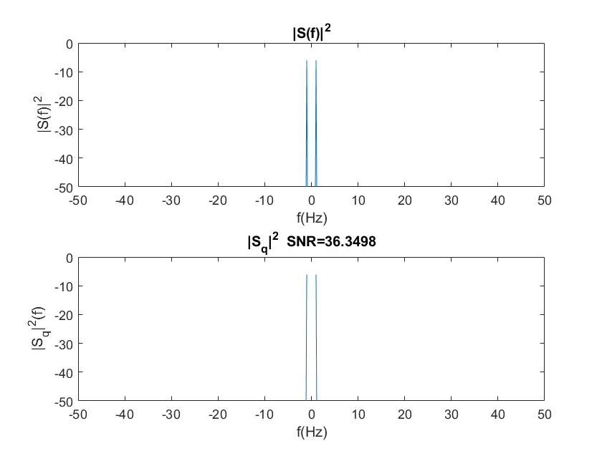

These other examples represent the quantized signal with different values of m.
As said before, the higher is m, the more accurate is the quantized signal compared to the original and the noise contribution becomes more negligible.
Furthermore, the SNR relation is verified.

